Slide 1
Jim Skea, IPCC Chair Diana Ürge-Vorsatz, IPCC Vice-Chair Robert Vautard, Working Group I Co-Chair Bart van den Hurk, Working Group II Co-Chair Zinta Zommers, Working Group II Vice-Chair Jan Sigurd Fuglestvedt, Working Group III Vice-Chair Oliver Geden, Working Group III Vice-Chair
IPCC Briefing for the members of the Latvian Parliament
17 April 2024
Speakers:

Slide 2
Jim Skea
IPCC Chair

Slide 3
Diana Ürge-Vorsatz
IPCC Vice-Chair

Slide 4
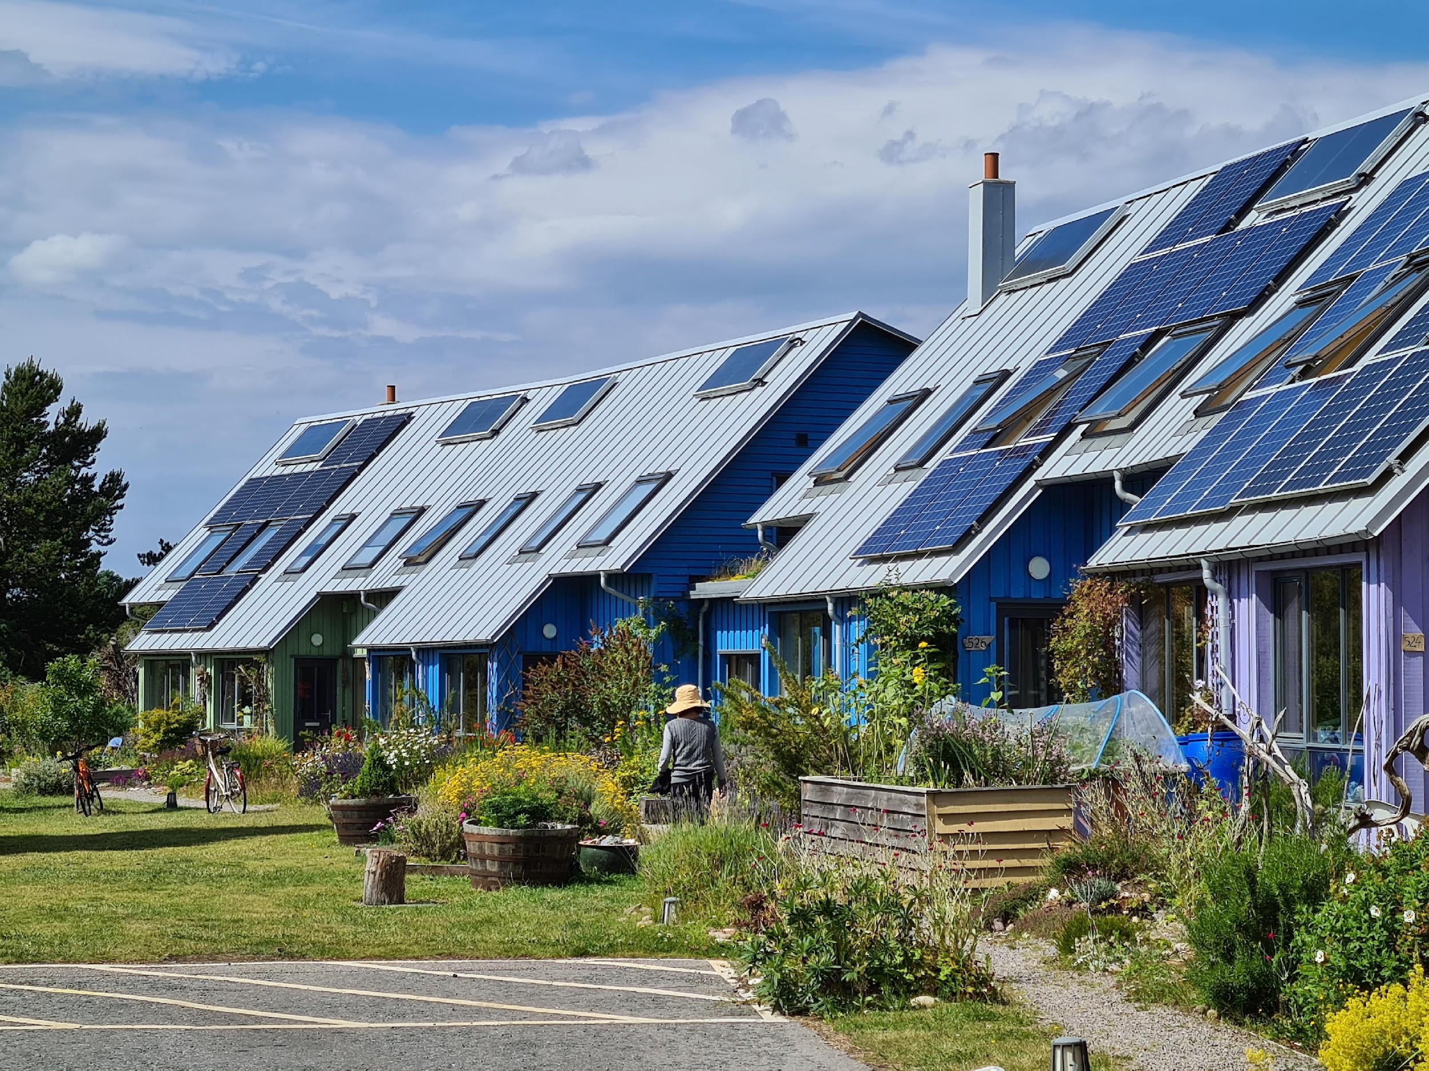
Sixth Assessment Report
WORKING GROUP III – MITIGATION OF CLIMATE CHANGE
Climate Change 2022
Pathways to solutions: opportunities on the demand-side
Move shapes based on amount of text to maximize photo space
[Matt Bridgestock, Director and Architect at John Gilbert Architects]
Notes:
Thank you. Before I start, I’d like to take this opportunity to thank the authors who volunteered countless hours to work on this report, often under difficult circumstances due to the pandemic.
I would also like to thank my fellow Co-Chair, Priyadarshi Shukla, who is unable to be here today. We have worked side-by-side for five years to guide the work on this report.
[SWITCH TO SLIDES]
In his place, I am joined by two of the Working Group III Vice-Chairs, Diana Urge-Vorsatz and Ramon Pichs Madruga.
Together, we are pleased to present the findings of this Working Group III assessment of the mitigation of climate change.
[NEXT SLIDE]

Slide 5
Illustrative Mitigation Pathways (IMPs) => There are many ways to achieve net zero … with benefits and risks to each.
Negative Emissions technologies
Negative Emissions technologies
PRIMARY ENERGY
Renewables
Low Demand
Sustainability
GHG EMISSIONS
Credit: Keywan Riahi (IIASA)

Slide 6
There are options available now in every sector that can at least halve emissions by 2030
Switch to blue logo for contrast when necessary
Demand and services
Move/scale shape based on amount of text to maximize photo space
Energy efficiency
Energy
Land use
Industry
Urban
Buildings
Transport
Notes:
[SWITCH TO CAMERA]
[pause]
Thank you Jim. I am Diana Urge-Vorsatz, one of the Vice-Chairs of Working Group III. What I would like to do now is to take you through the options that are available in each sector to combat climate change.
[SWITCH TO SLIDES]
In every sector there are options available now that can at least halve emissions by 2030 and keep open the possibility of limiting warming to 1.5°C.
Let’s work through these.
[NEXT SLIDE]

Slide 7
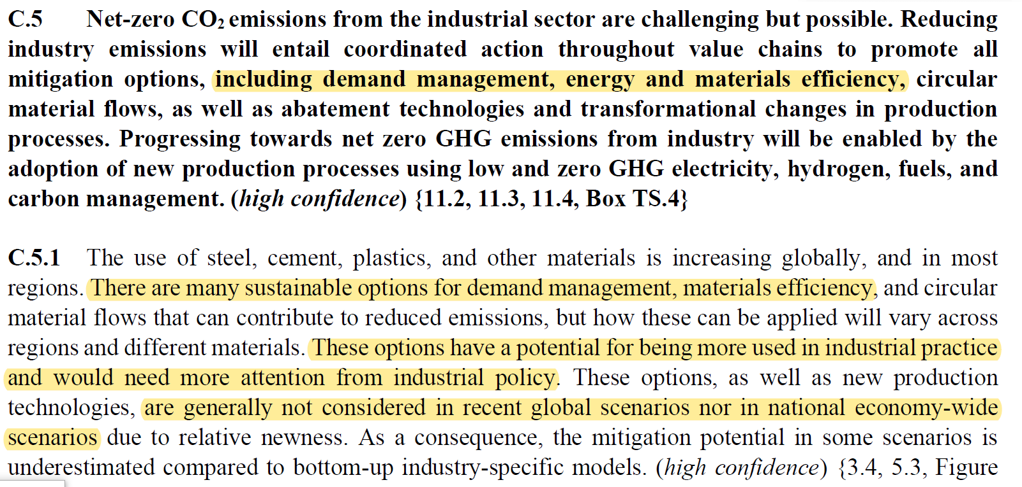

Slide 8
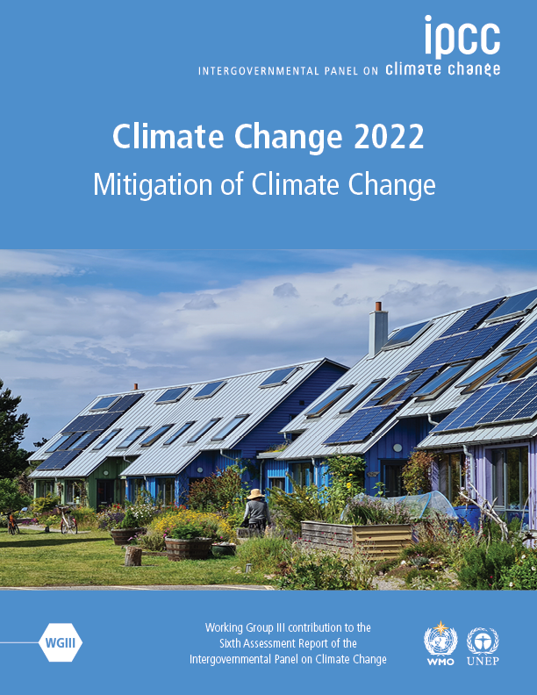
In developed countries, technological, social, business (model) innovations for rethinking and restructuring existing urban space, repurposing, retrofitting and reusing existing infrastructure, vehicle stocks and equipment rather having to build/produce new enable faster carbon neutrality and higher level of flexibility on the supply side, as well as a many synergies with local social and economic goals
[Matt Bridgestock, Director and Architect at John Gilbert Architects]
Notes:
In the next 20 minutes we will set out our key findings, showing where we are in terms of greenhouse gas emissions, where we are headed, and what action we can take to limit global warming.
[CLICK]
The reality is that greenhouse gas emissions, which are causing global warming, are at their highest levels in human history.
[NEXT SLIDE]

Slide 9
The built environment is crucial for a carbon neutral future
Net zero energy buildings are feasible in all climates and economic for almost all building types
Key to this is maximised energy efficiency and minimised energy and material demand
This requires prioritisation of net zero energy retrofit and repurposing of existing building stocks and repair of components over new ones, wherever applicable
durable, long-life buildings & components, with warranties and accessible repair services
Consideration of the substitution of high-emission materials, esp. cement and steel, by bio-based materials
Maximised use of bio-based materials and urban green infrastructure for Carbon capture and storage

Slide 10
Mitigation options in urban areas

Slide 11
Thank you for your attention
Diana Ürge-Vorsatz
vorsatzd@ceu.edu
www.ipcc.ch
Twitter:
@DianaUrge
dr_Diana_UrgeVorsatz
Diana Ürge-Vorsatz
diana.urgevorsatz

Slide 12
Robert Vautard
Working Group I Co-Chair

Slide 13
Bart van den Hurk
Working Group II Co-Chair

Slide 14
Update of the adaptation guideline – practical value for regions and cities
Prof. Bart van den Hurk
Co-chair IPCC WG2

Slide 15
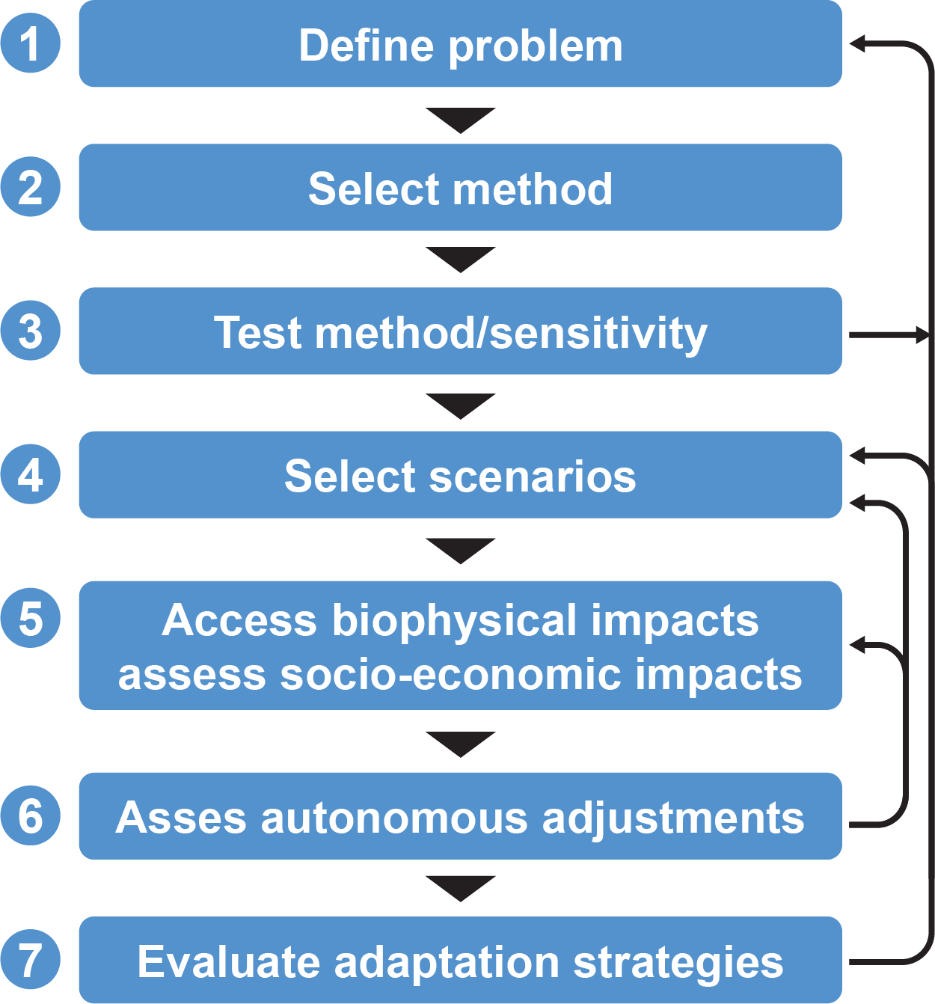
The 1994 Impacts and Adaptation Guideline
What’s the climate pressure?
What does it do to the nation/region?
How will that change?
What adaptation is required?
Update in AR7
New climate insights
New data and scenarios
New adaptation insights
New experience from case studies

Slide 16
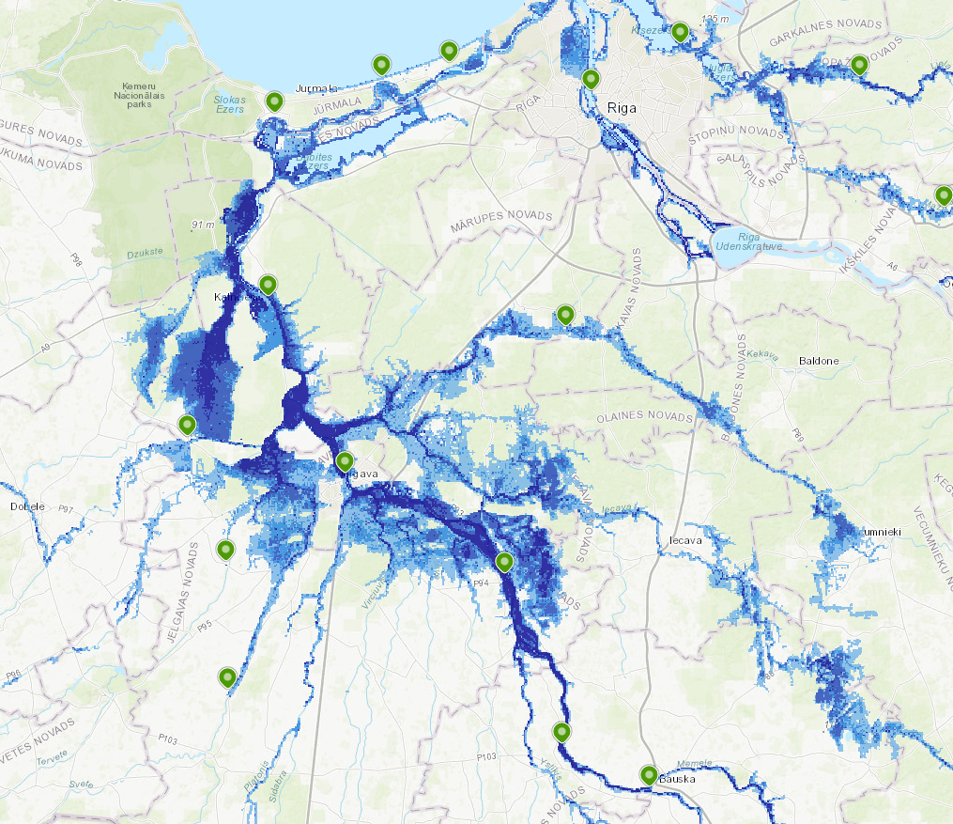
The European Climate Mission – latvia focus area
Support to regions with funding and technical support
Update Climate Risk Assessment
Develop Adaptation strategies
Focus area Latvia
With LVGMC
Using local climate & socio-economic data
Embedded in national adaptation strategy

Slide 17
The European Climate Mission – latvia focus area
Support to regions with funding and technical support
Update Climate Risk Assessment
Develop Adaptation strategies
Latvia Adaptation Plan 2019
Inventory of sectoral risks

Slide 18
Thank you

Slide 19
Paldies

Slide 20
Zinta Zommers
Working Group II Vice-Chair

Slide 21
SIXTH ASSESSMENT REPORT
IPCC AR6 SYR Figure 2.3c - Human Systems

Slide 23
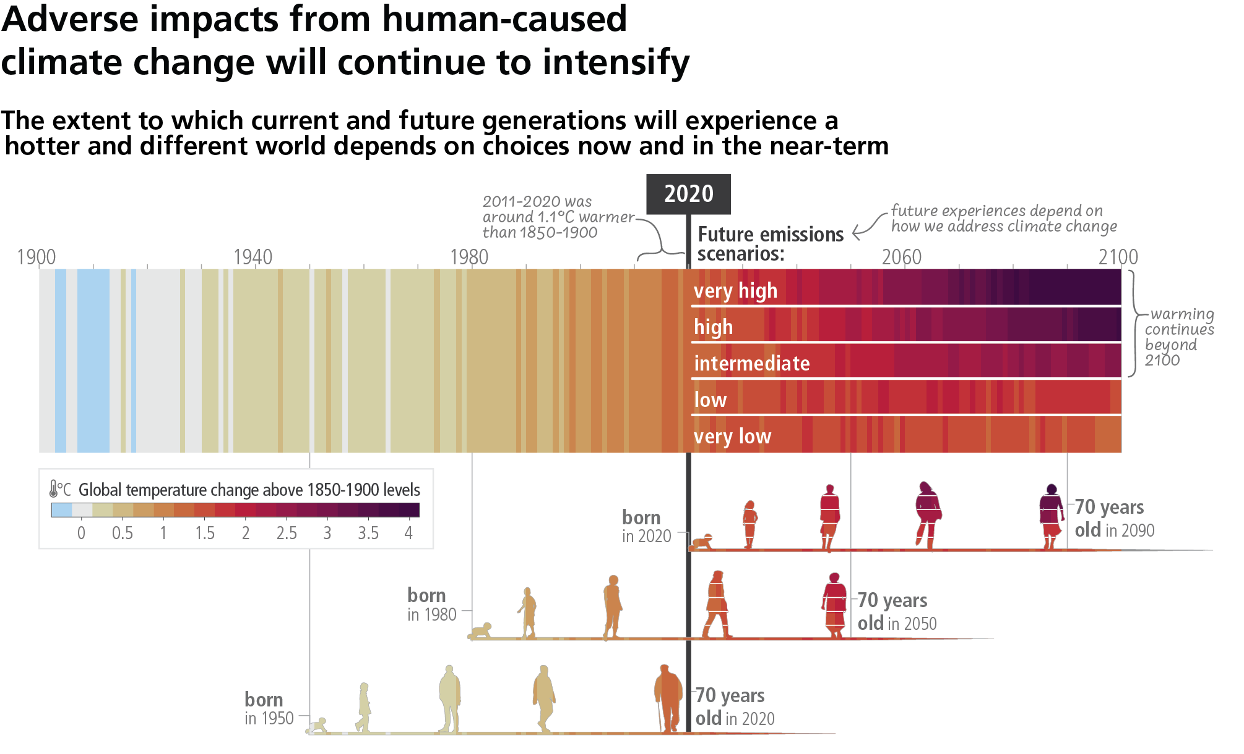
SIXTH ASSESSMENT REPORT
IPCC AR6 SYR Figure SPM.1c

Slide 24
Contribute to existing literature
IPCC assessments are as good as the literature available. Look out for the various cut off dates for literature for the different reports.
As Authors or Review Editors
Bureau selects Authors and Review Editors from lists of nominations provided by governments and observer organizations.
As Expert Reviewers
To be involved in the two review stages: Expert Review of the First Order Draft and Government and Expert Review of the Second Order Draft

Slide 25
Jan Sigurd Fuglestvedt
Working Group III Vice-Chair

Slide 26
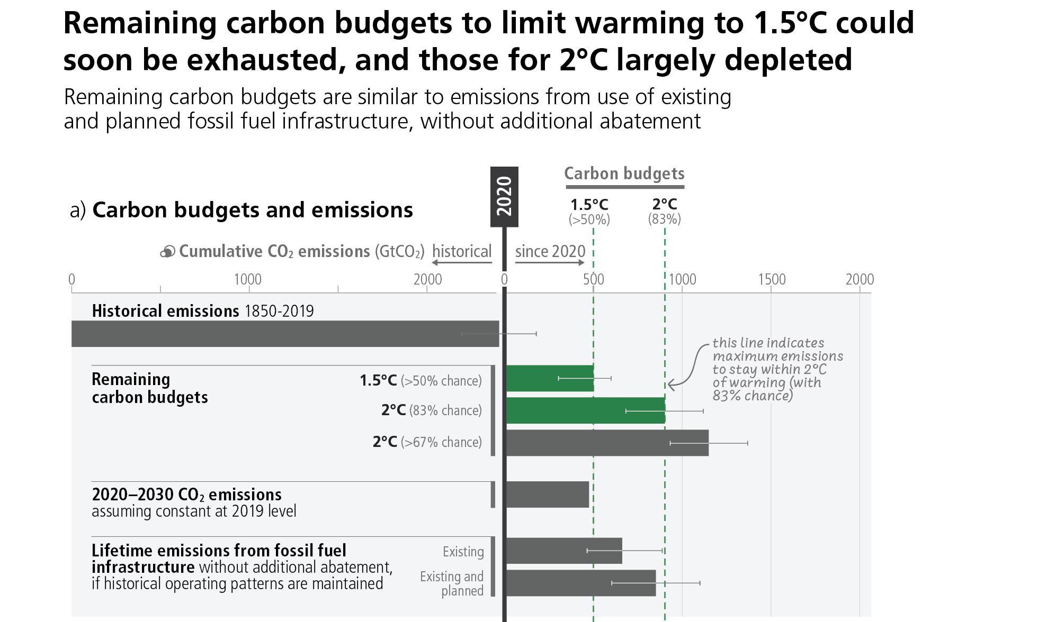

Slide 30
Mitigation options
From Figure SPM7.a IPCC AR6 Synthesis Report

Slide 31
Options costing 100 USD/tCO₂-eq or less could reduce global emissions by at least half of the 2019 level by 2030
From Figure SPM7.a IPCC AR6 Synthesis Report

Slide 32
Oliver Geden
Working Group III Vice-Chair

Slide 33
THANK YOU
FOR YOUR ATTENTION
STAY IN TOUCH
STAY CONNECTED
ipcc_ch
ipcc
@ipcc
ipcc.ch
ipcc-sec@wmo.int
ipcc-media@wmo.int
ipcc
ipccGeneva

